Slide 1
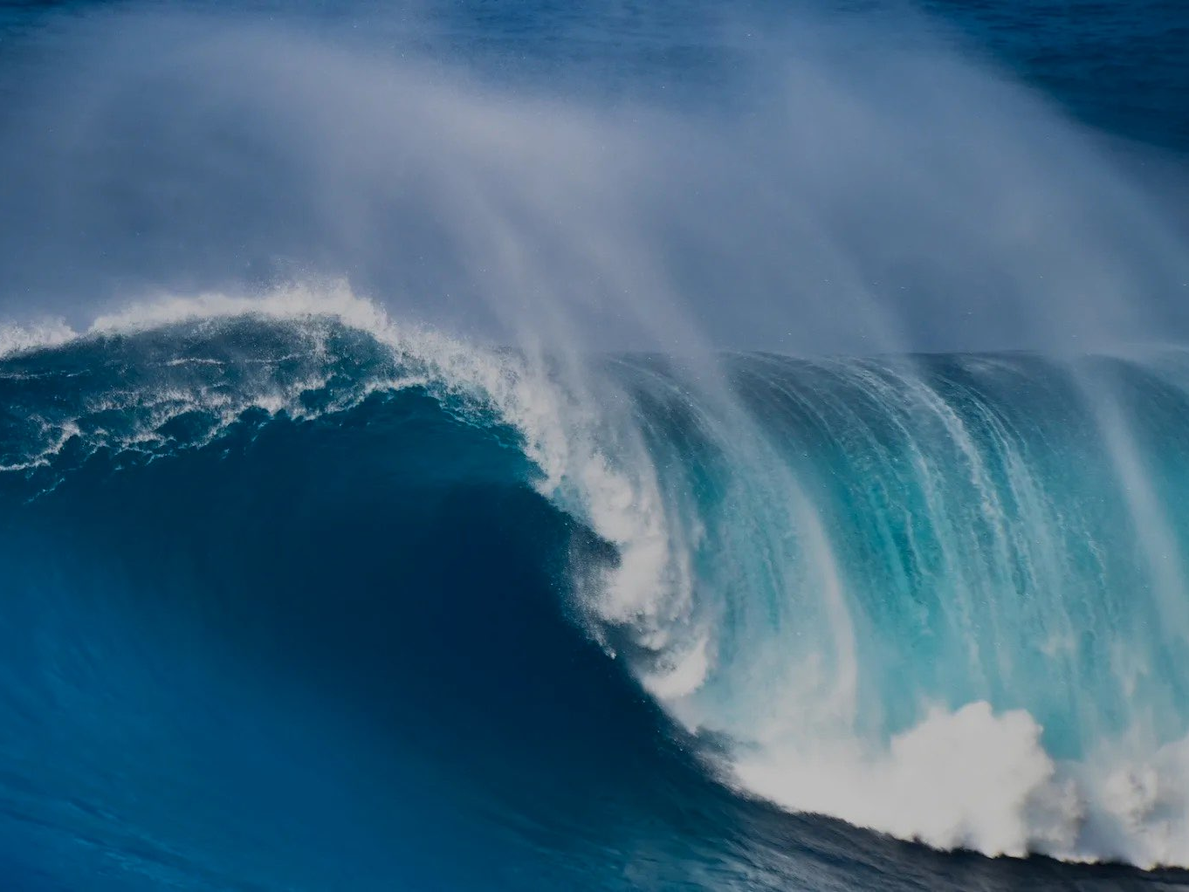
SwellSight
Your Smart Guide to Surf Conditions
eliya ZAKAY, Shalev ATSIS, sam SOTIL

Slide 2
Project Review
Project Motivation and Core Specifications
Goal: Provide objective surf metrics from 2D images.
Core Task: Multi-task computer vision model predicting:
Wave height (regression: 0.1-10.0)
Wave breaking style (4-class classification: A_FRAME, CLOSEOUT, BEACH_BREAK, POINT_BREAK)
Wave direction (3-class classification: LEFT, RIGHT, BOTH)

Slide 3
Project Review
Changes from Proposal
Originally: Model predicts parameters, then a separate system converts them into a “Surf Score”.
Now: We do not build the scoring system, our project output is parameters only.
Deliverable (Model): Image → {Height, Type, Direction}.
Data generation: parameters → depth map (beach camera) → ControlNet → photorealistic images with automatic labels.

Slide 4
Project Review
Novelty & Contribution:
Multi-task Architecture: Single model handling regression + dual classification tasks
Synthetic Data Pipeline: Depth map-guided wave generation using ControlNet + Stable Diffusion.
Real-Synthetic Integration: Mixed training approach (25% real, 75% synthetic data).
Domain-Specific Innovation: First application of depth-controlled diffusion models for oceanographic data.

Slide 5
Previous Work
Paper 1: Adding Conditional Control to Text-to-Image Diffusion Models
Paper 2: Deep Learning Object Detection Application to Surfing Wave Quality
Paper 3: AdaBins: Depth Estimation Using Adaptive Bins
Paper / Year | Task | Methods | Data | Relation to SwellSight
Zhang et al. (ControlNet, 2023) | Conditional Image Generation | Adding spatial conditioning to Diffusion models | Large Scale (LAION) | Foundation for our Data Gen: We use this to turn Depth Maps into Waves.
Wouters et al. (SurfNet, 2019) | Wave Classification | CNN for classifying surf height ranges | Real images (scraped) | Baseline Task: Similar classification goal, but we add precise regression & synthesis.
Bhat et al. (AdaBins, 2021) | Depth Estimation | Transformer-based depth estimation from 2D | NYU Depth V2 | Inverse Problem: They go → Depth; We go Depth → 2D to create training data.

Slide 6
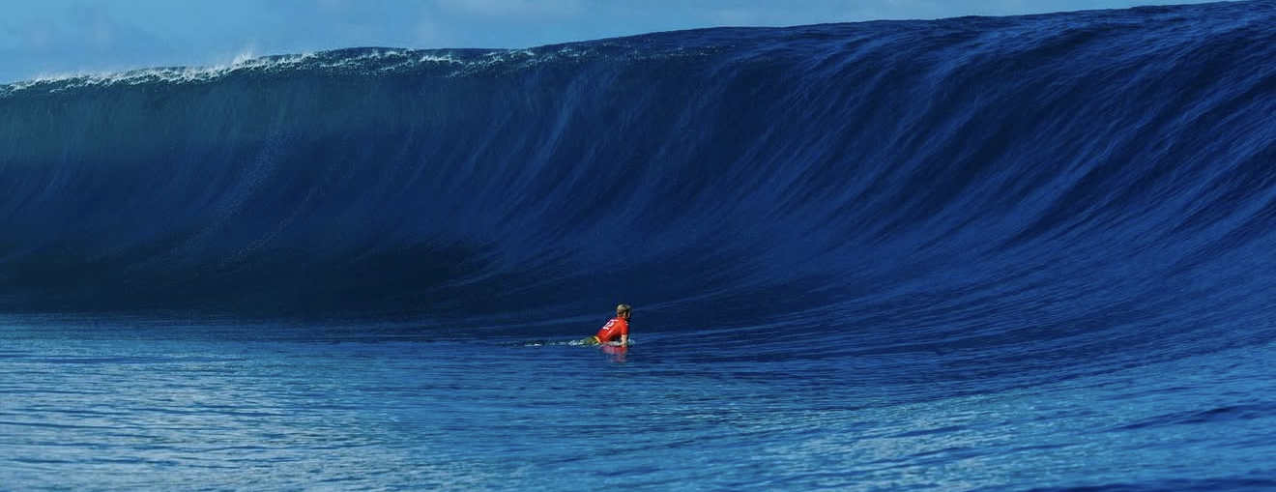
Dataset
Dataset Description:
Synthetic Data: Automated labeling from depth map parameters
Small real-world dataset used only for domain adaptation and validation.
Depth maps define exact 3D wave structure (height, shape, angle)
ControlNet + Stable Diffusion renders photorealistic textures
Ground truth labels extracted with 100% accuracy from generation parameters

Slide 7
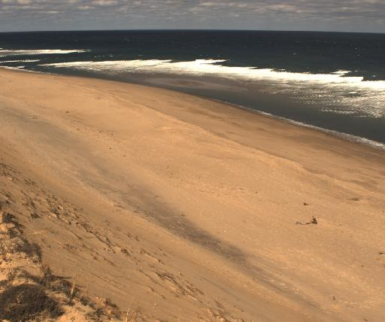

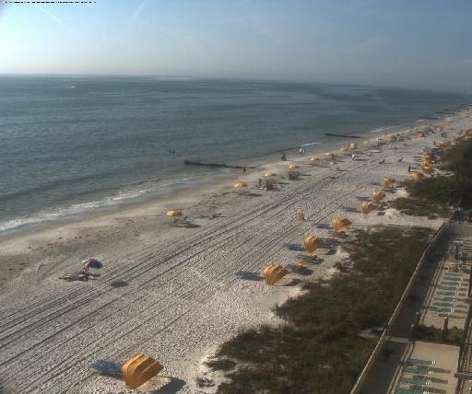
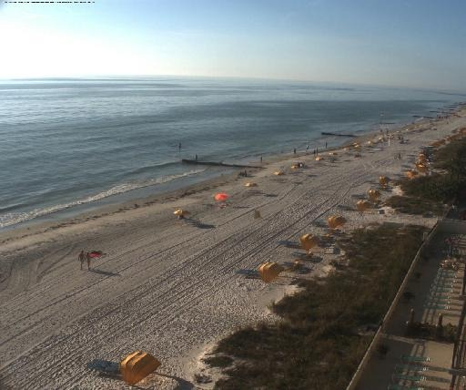
Dataset

Slide 8
Dataset
Quality Assessment per Task:
Parametric Geometry: generate a depth map from controlled wave parameters + beach camera setup (perspective, noise, occlusions, run-up).
Texture Rendering: The Depth Map is fed into Stable Diffusion + ControlNet with prompts (for example- "Sunny day, blue ocean").
Automatic Labeling: The parameters used in step 1 become the Ground Truth labels (No manual labeling needed).

Slide 9
Dataset
Exploratory Data Analysis (EDA) Summary:
Planned Dataset Composition:
Target Size: 10,000 synthetic images + 729 real images
Training Split: 70% train, 15% validation, 15% test
Real:Synthetic Ratio: 1:14 (6% real, 94% synthetic)
Class Distribution (Planned):
Wave type | Target
A_FRAME | 25%
CLOSEOUT | 25%
BEACH_BREAK | 25%
POINT_BREAK | 25%
Direction | Target
LEFT | 33%
RIGHT | 33%
BOTH | 34%

Slide 10
Dataset
Exploratory Data Analysis (EDA) Summary:
Wave Height Distribution:
Range: 0.5m - 4.0m (log-normal distribution)
Mean: 2.5 m
Input Specifications:
Image Size: 512×512 pixels (arbitrary input resolution supported)
Format: RGB images (JPG/PNG)
Preprocessing: ImageNet normalization, aspect ratio preservation

Slide 11
Baseline solution and results
Baseline Model Architecture:
Backbone: ResNet-50 with ImageNet pre-trained weights.
Architecture: Shared encoder + task-specific heads
Loss Function: Multi-task weighted loss (Smooth L1 + CrossEntropy)
Training: AdamW optimizer, cosine annealing scheduler
Height Head: Linear(2048→512→1) with ReLU + Dropout(0.3)
Type Head: Linear(2048→512→4) with ReLU + Dropout(0.3)
Direction Head: Linear(2048→256→3) with ReLU + Dropout(0.3)

Slide 12
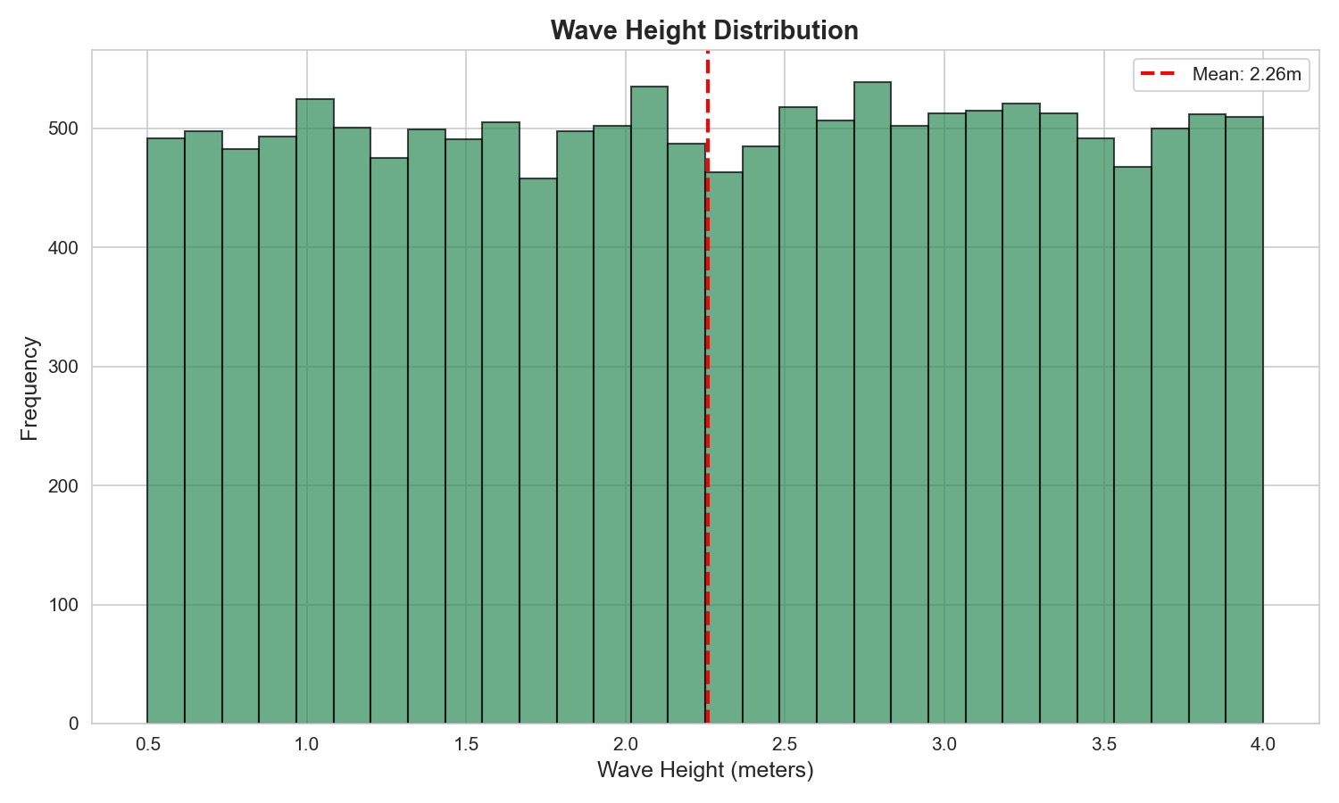
Baseline solution and results
Synthetic data results:

Slide 13
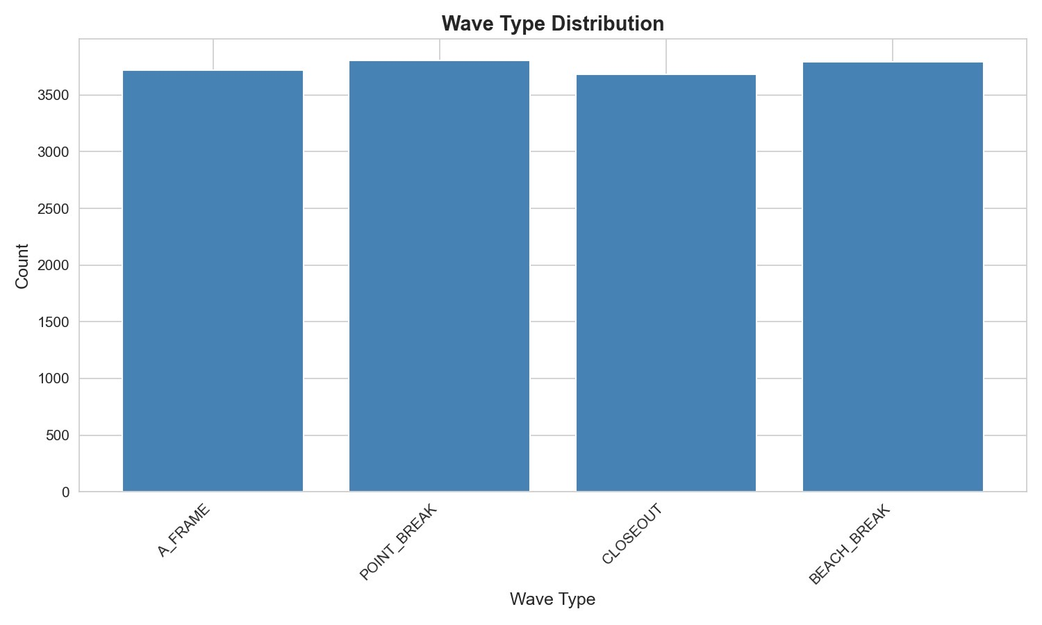
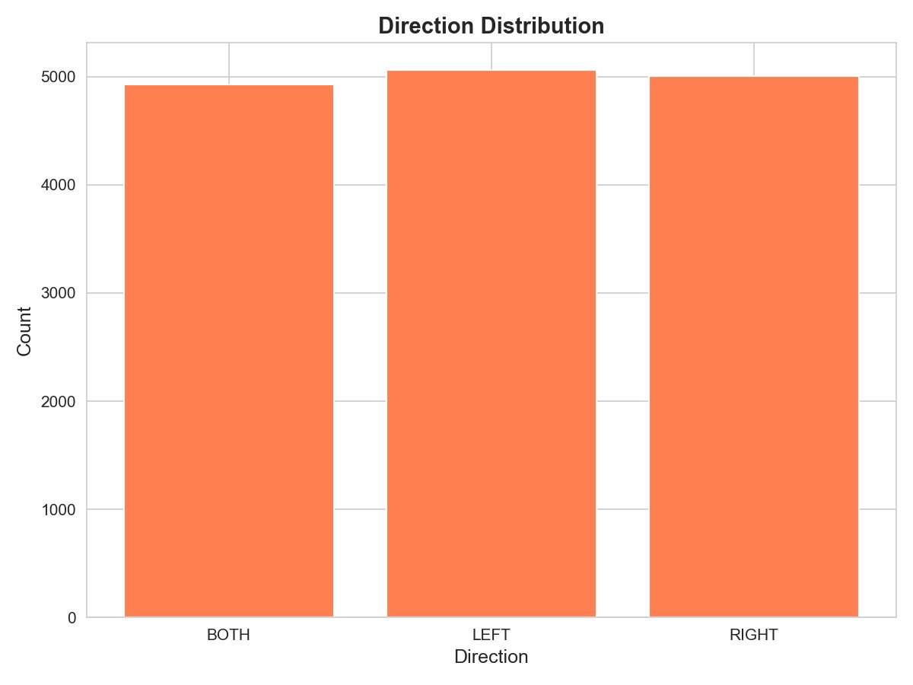
Baseline solution and results
Synthetic data results:

Slide 14
Baseline solution and results
Preliminary Results (Evaluation):
Synthetic data generation: synthetic beach cam images quality and accuracy are insufficient.
Error Analysis:
Issue: The model analysis of the real dataset does not function well. it leads to bad synthetic data generation.
Action item: understanding RCA to solve the issue.

Slide 15
Plan
Step | Scope/Models Used | Expected Outcome | Due Date
Model Tuning | Multi-Task Backbone | Improved F1-Scores | Week 9
Domain Adaptation | Noise/Lighting Augmentation | Better real-world accuracy | Week 10
Final Testing | Real-world Validation Set | Visual consistency report | Week 11
Final Wrap-up | Documentation | Prepare Final Presentation | Week 12

Slide 16
Feedback
Create depth maps from your real dataset
Use MiDaS model in order to create the depth maps
Preform data augmentation from the depth maps
Data augmentation should be preformed with different attributes
Use controlNet to create synthetic images from the depth maps

Slide 17
Actual Implementation
Built a labeled real beach-image dataset and split it into train, validation, and test sets.
Generated depth maps for the real images using a DPT depth model, then applied depth augmentations to increase variation.
Used SDXL + ControlNet Depth to synthesize photorealistic wave images from the augmented depth maps, and also generated extra parameter-based depth maps to cover more wave types, directions, and heights.

